Slide 1
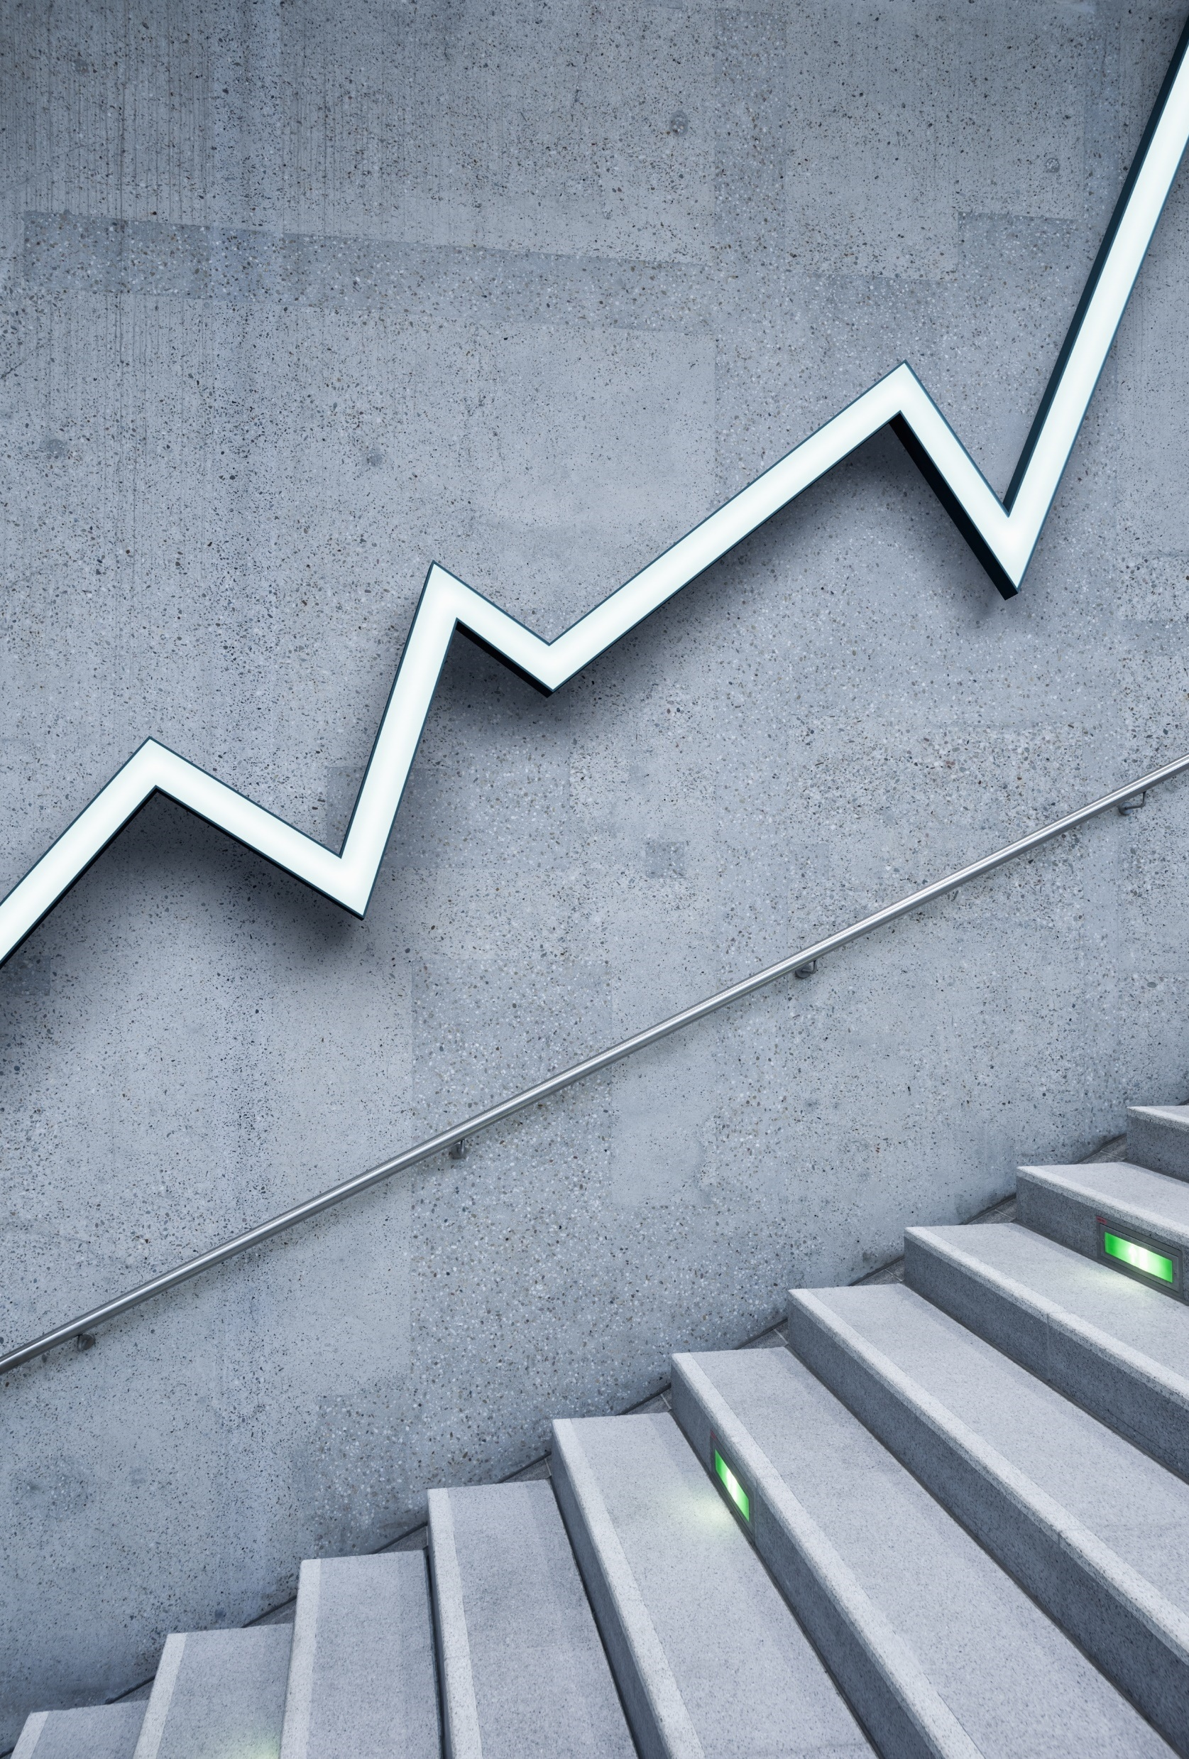
New Shopping Mall Bengaluru, India IBM - Applied Data Science Capstone May 2020
- Nithin Balaji

Slide 2
INTRODUCTION
The city of Bengaluru, in Karnataka is called as the Silicon Valley of India.
This city is flooded with IT and Tech companies which boosts the GDP per capita of the city marking its place at fifth position in India [1].
Therefore, the buying potential of individuals is growing rapidly in this city.
For individuals, visiting shopping malls are like a one-stop destination for satisfying all their needs such as grocery shopping, dine at restaurants, fashion outlets, play games and watch movies.
Retailers and Property developers are taking advantage of this trend to build more shopping malls to balance and meet the demand and supply.

Slide 3
TARGET AUDIENCE
The target audience of this project is anyone who interested in constructing a shop mall but are facing difficulties in which neighbourhood the mall to is to be constructed to attract maximum customers.

Slide 4
DATA COLLECTION
Latitude and longitude coordinates of those neighbourhoods. This is required in order to plot the map.
Venue data, particularly data related to shopping malls. We will use this data to perform clustering on the neighbourhoods.
The geographical coordinates are collected using Python Geocoder package
The details for the mall location is scrapped from the FourSquare developers website.

Slide 5
DATA ATTRIBUTES
Neighbourhood
Latitude
Longitude
Venue Name
Venue Latitude
Venue Longitude
Venue Category

Slide 6
METHODOLOGY
1. Understanding the business problem
2. Data collection
3. Data cleaning
4. Modelling
5. Data Visualization
6. Business insights
7. Data Driven decision

Slide 7
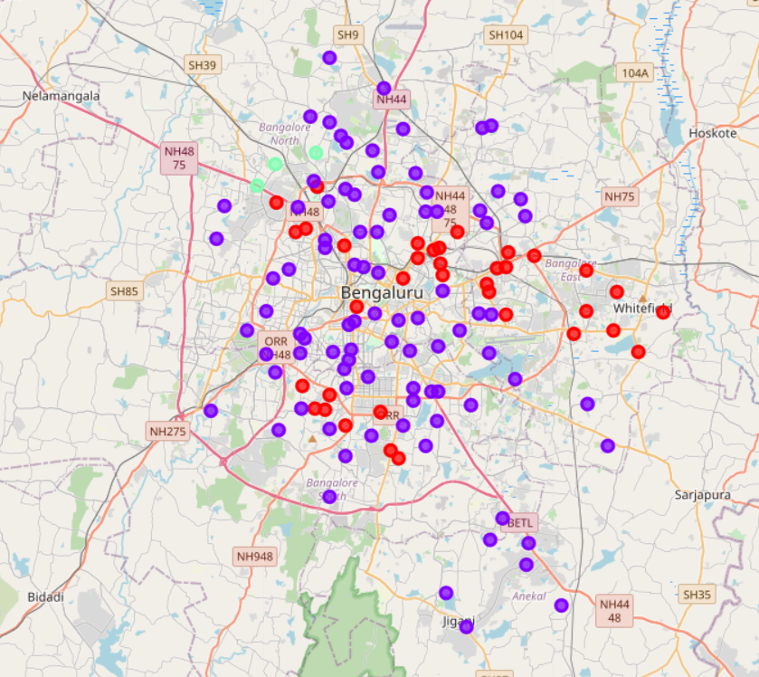
RESULTS
Cluster 0 [Red]: Areas with moderate number of shopping malls
Cluster 1 [Purple]: Areas with low number to no existence of shopping malls
Cluster 2 [Green]: Areas with high concentration of shopping malls
Fig 1 – Map showing clusters (k - means Clustering)

Slide 8
CONCLUSION
From the map it can be seen that the Eastern and the North-Western parts of the city is flooded with malls
The count of malls in the southern part of the city is relatively less.
This part of Bengaluru being newly developed is the optimal location for building a new Shopping Mall
The optimal areas include, 4.1 Electronic city phase - 1 4.2 Electronic city phase - 2 4.3 Anekal 4.4 Jigani 4.5 Surya Nagar phase - 1 4.6 Bommasandra
This represents a great opportunity and high potential areas to open new shopping malls as there is no competition.

